Slide 1

FlashNode
Covid Alert

Slide 2
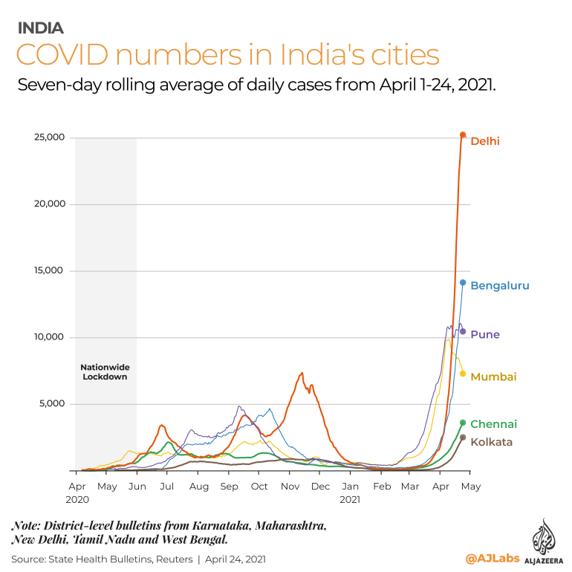
Our Inspiration
We are all aware of the global and economic impact of Sars-Covid19. Authorities are attempting to control the chaos that has erupted as a result of the public's fear. Covid-Alert is a tiny endeavor aimed at calming and informing people about the Covid-19 pandemic and assisting them in understanding what they need to do to stay safe from it. It also provides authorities with a remedy. It is simple to build and scale without requiring a lot of resources.

Slide 3
Vision, Mission and Goal
Our goal is to consolidate the Covid-19 data and make it available and helpful across the country.
We are dedicated to making India a Covid-free country.
Discipline and accurate information are the keys to saving oneself in this time.
As a result, we'd like to introduce our product: Covid-Alert

Slide 4



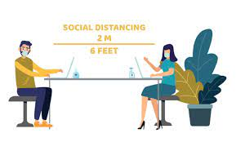
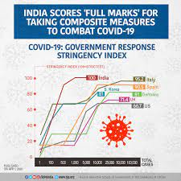
What it does
Essentially, we provide a platform for the general public to view all relevant Covid-19 information (such as the number of cases, origin, and how they can save themselves) as well as a software for government agencies to protect and track people who are not wearing masks or following social distancing norms. Government agencies can use this information to take appropriate action against the violators, as a result, people's health is protected.

Slide 5






How we built it
We have used HTML5, CSS-3 and Bootstrap for Web Development.
For our software we used Python, deep learning- TensorFlow and Keras and some acknowledgeable references to develop our face detector and distancing model .
We have made full use of Adobe Premiere Pro, Google suite, and Microsoft 365 to create our website and design.

Slide 6
Challenges Faced by us
The application of tensor and Keras for detecting mask was a huge difficulty for us in the backend, therefore we enlisted some help in constructing the script to train the system to recognize people with and without mask.
We discovered that deciding on a webpage design is much more difficult than it appears and is seemingly impossible to figure out in a few hours. We got a lot of help from the internet.

Slide 7

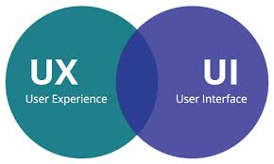

Accomplishments that we're proud of
After spending a lot of time researching the only thing that came close to our idea – Making India Corona free and spreading awareness – we created a service that not only has a clean, minimalistic UI/UX, but also doesn't require any training to use, saving both government agencies and our users money and time. The fact that we could code in an almost replica of our design prototype into the final product was an impressive achievement for us. We also explored and delved into many new technologies. It was a remarkable feat for us to be able to code in an almost exact reproduction of our design prototype into the final product. We also looked into and learned about a variety of new technology.

Slide 8
What we learned
We discovered more about the what and why of our country's sudden increase in Covid instances. There appeared to be no answer to the difficulties being solved, which led to the creation of our project. We learned how to use Tensor, Keras, Mapbox, and a variety of useful algorithms like Viola-Jones, Centroid-Tracking, and Non Max Suppression.

Slide 9


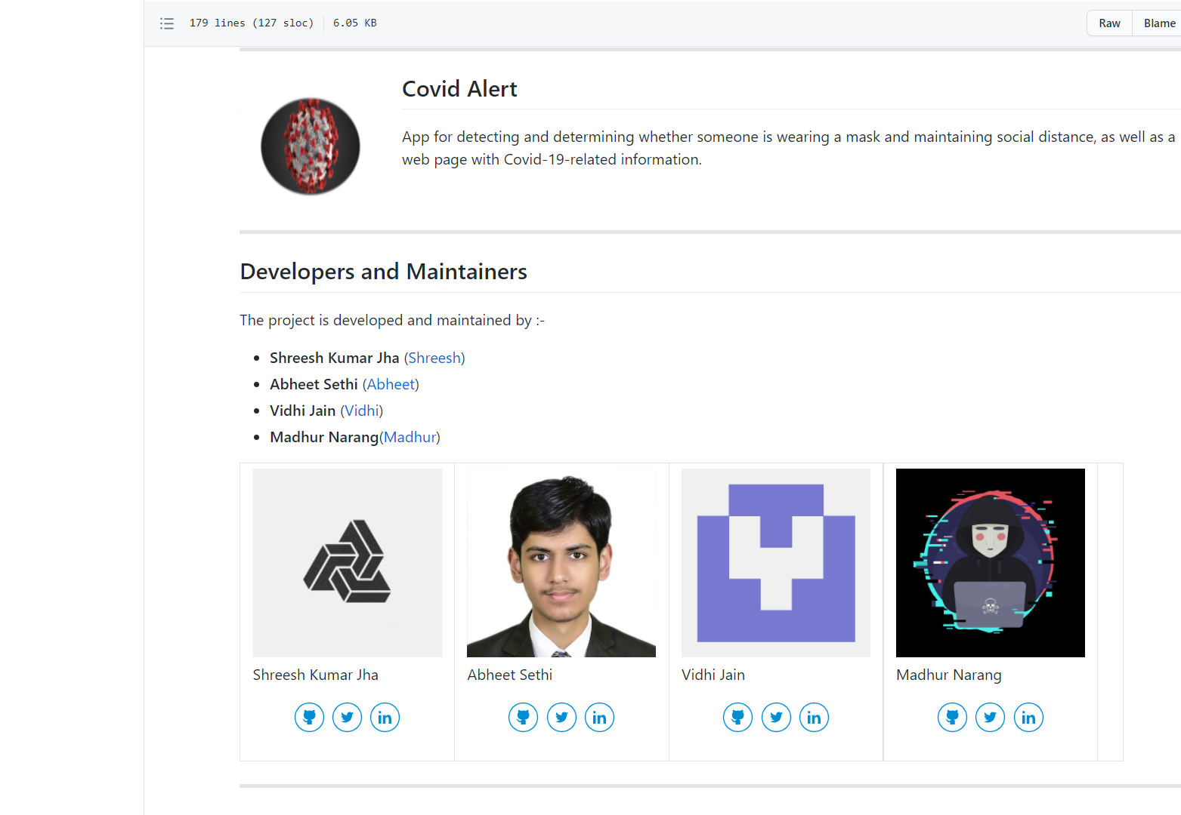
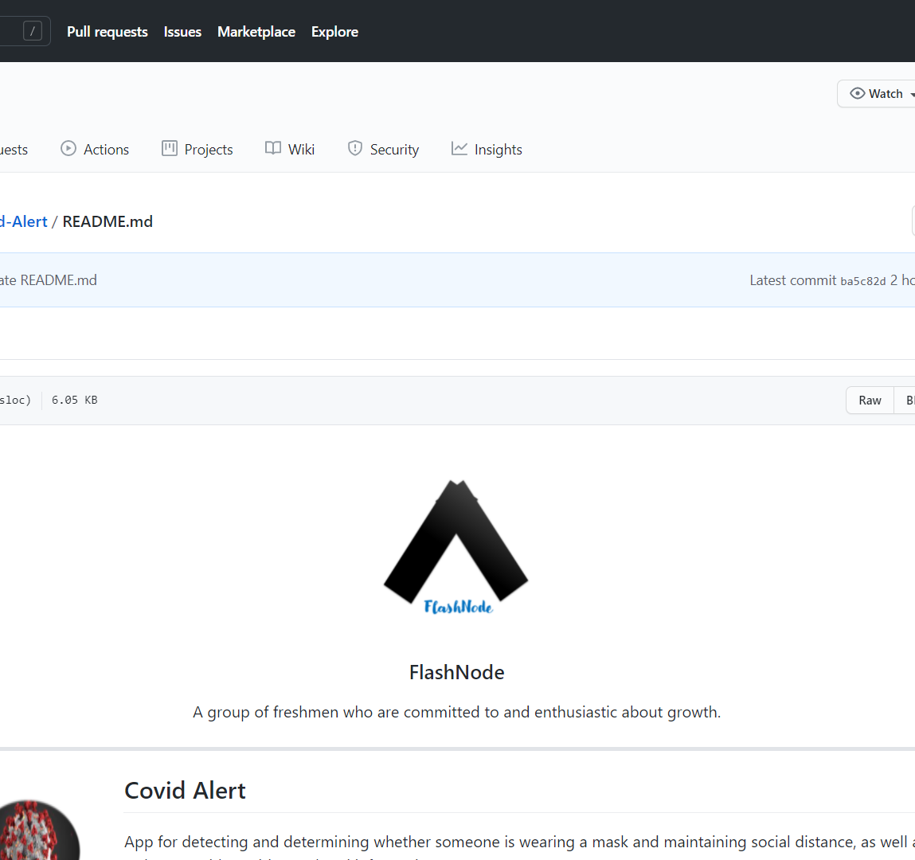
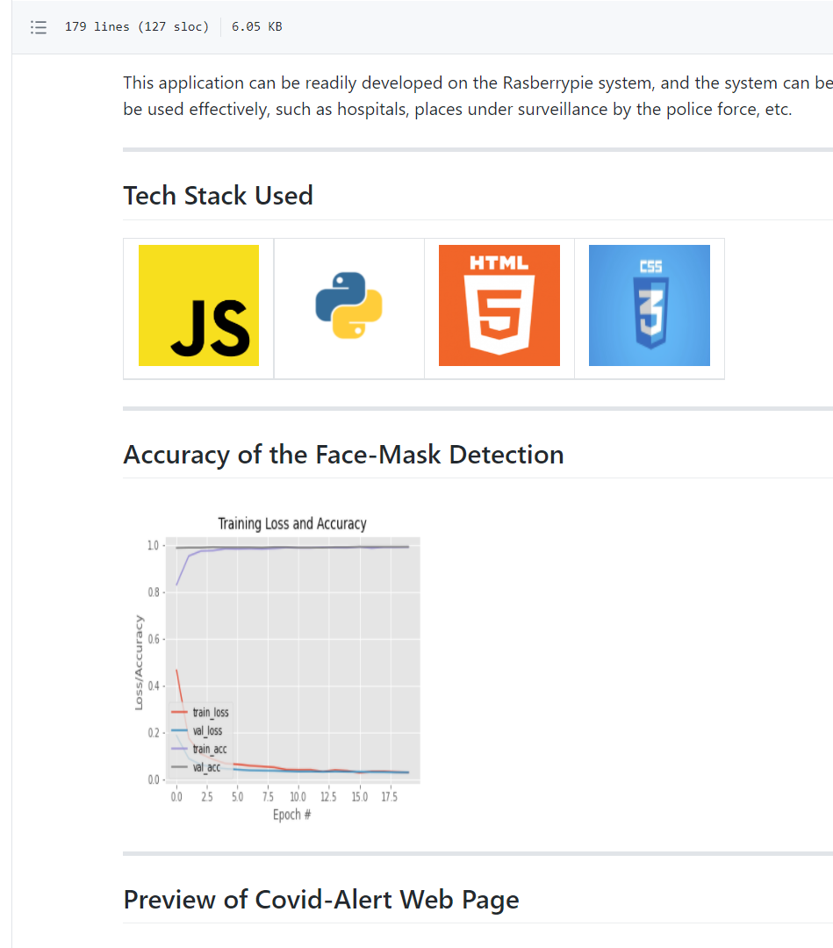
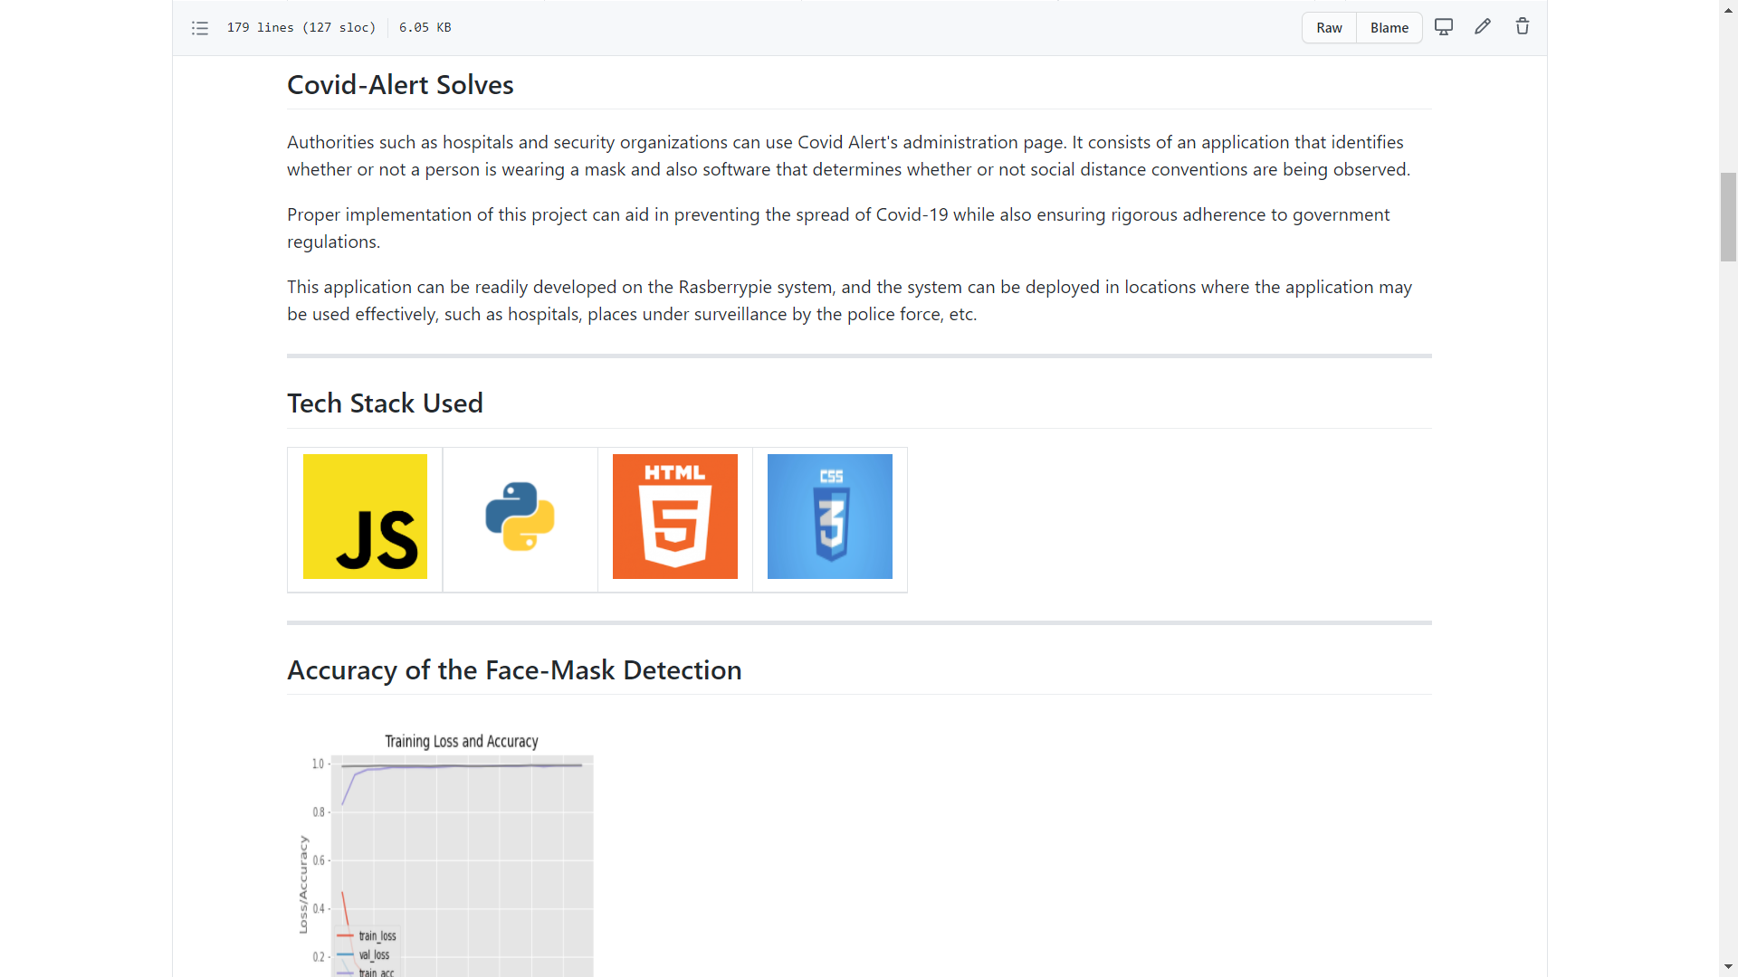

Our GitHub Documentation What we learned from the Incubate GitHub Workshop
We express our immense gratitude to Incubate for conducting an amazing workshop on GitHub on 28 May 2021 that gave us very fruitful information. The knowledge we gained led to the completion of our project.

Slide 10
Glimpse of our Work
https://www.behance.net/gallery/120358999/FlashNode-Covid-Alert

Slide 11
Upcoming Features
Notification on device related to covid.
Integration of dashboard with josh hopkins data.
Better info updates on live map dashboard

Slide 12
Our Team
We are Maharaja Agrasen Institute of Technology's first-year B.Tech Information Technology students.
Backend Developers:
Shreesh Kumar Jha: For my team, I worked as a backend developer and created the Face Mask Alert and Covid Dashboard for the web page. I also worked on documentation of the project on GitHub.
Parth Pasricha: I created Social Distancing Alert as a backend engineer for my team.
Front Developers:
Abheet Sethi: For my team, I worked as a frontend developer, responsible for website design and development, video editing, and presentation creation.
Vidhi Jain: I created all of the content on the website and conducted all of the research necessary to deliver relevant material.

Slide 13
Bibliography
google.com
youtube.com
behace.com
bootstrap.com
github.com
who.int/health

